Slide 1
October 16-17, 2024
Hyatt Regency Toronto Toronto, ON
DRIVING DATA IMPERATIVES
WITH DATA SERVICE TEAMS:
FIELD GUIDE INSIGHTS
Peter Stoyko
Design Lead and Information Designer
Public Health Agency of Canada

Slide 3
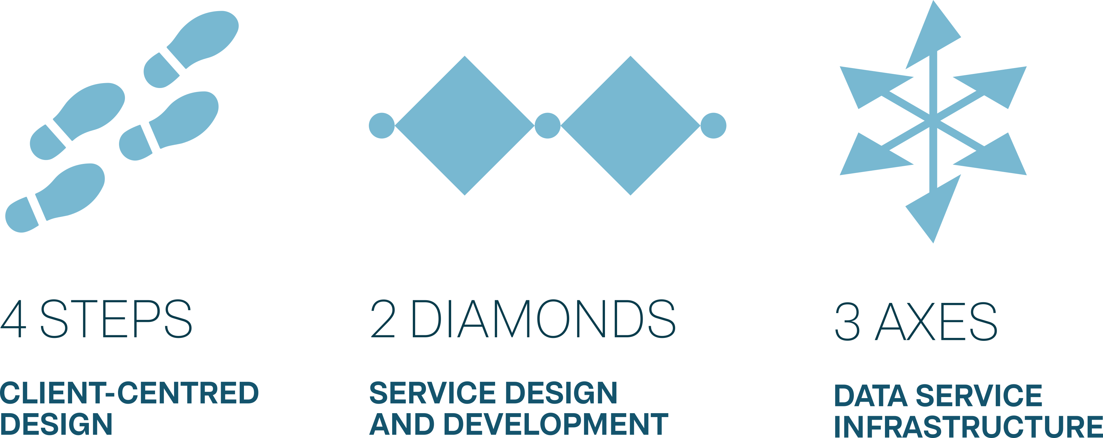

Slide 5
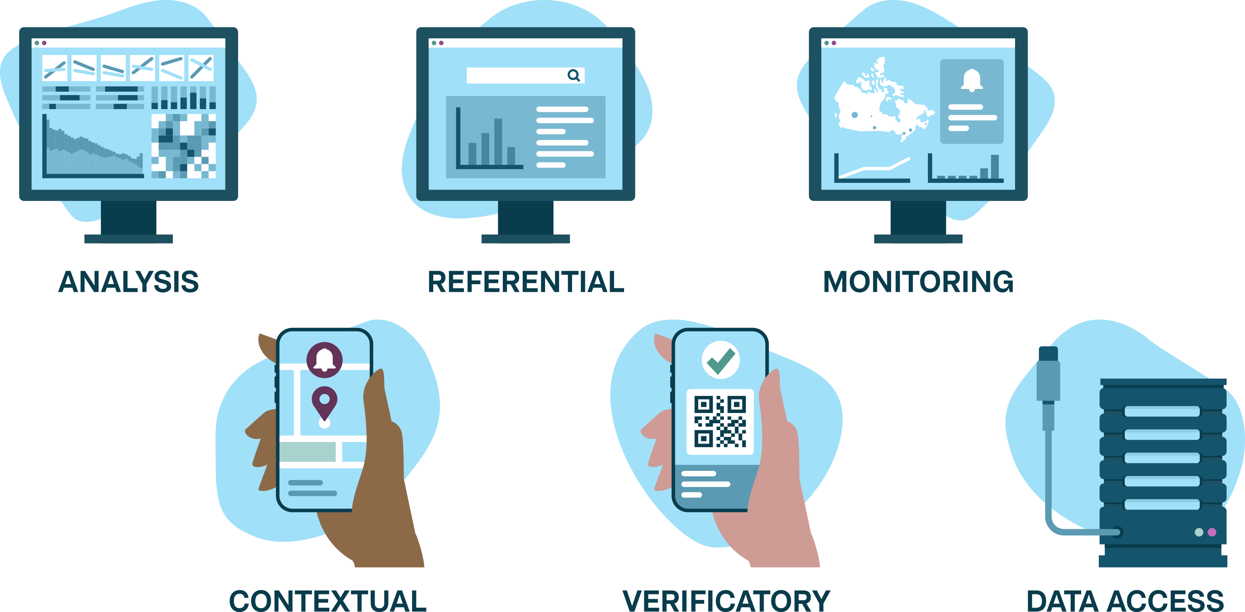

Slide 6
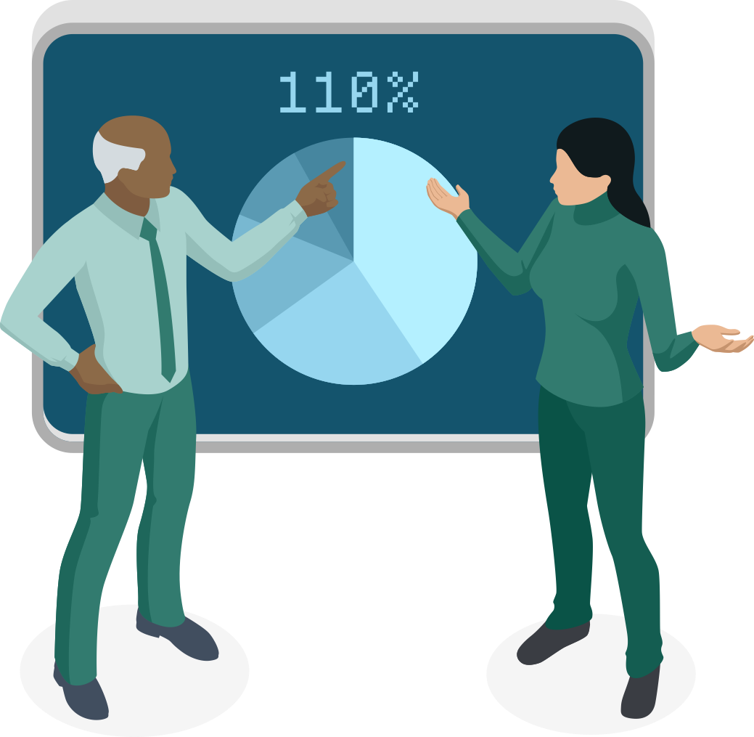

Slide 9
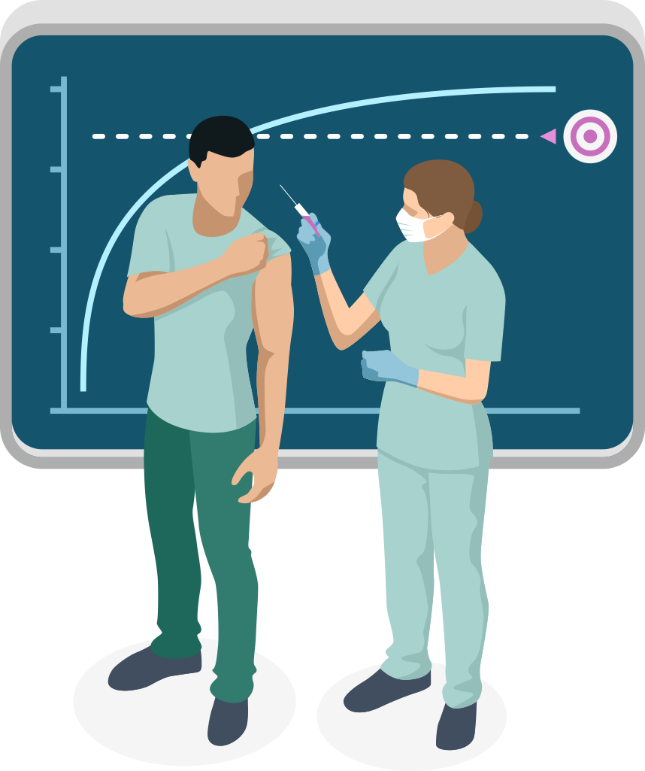

Slide 14
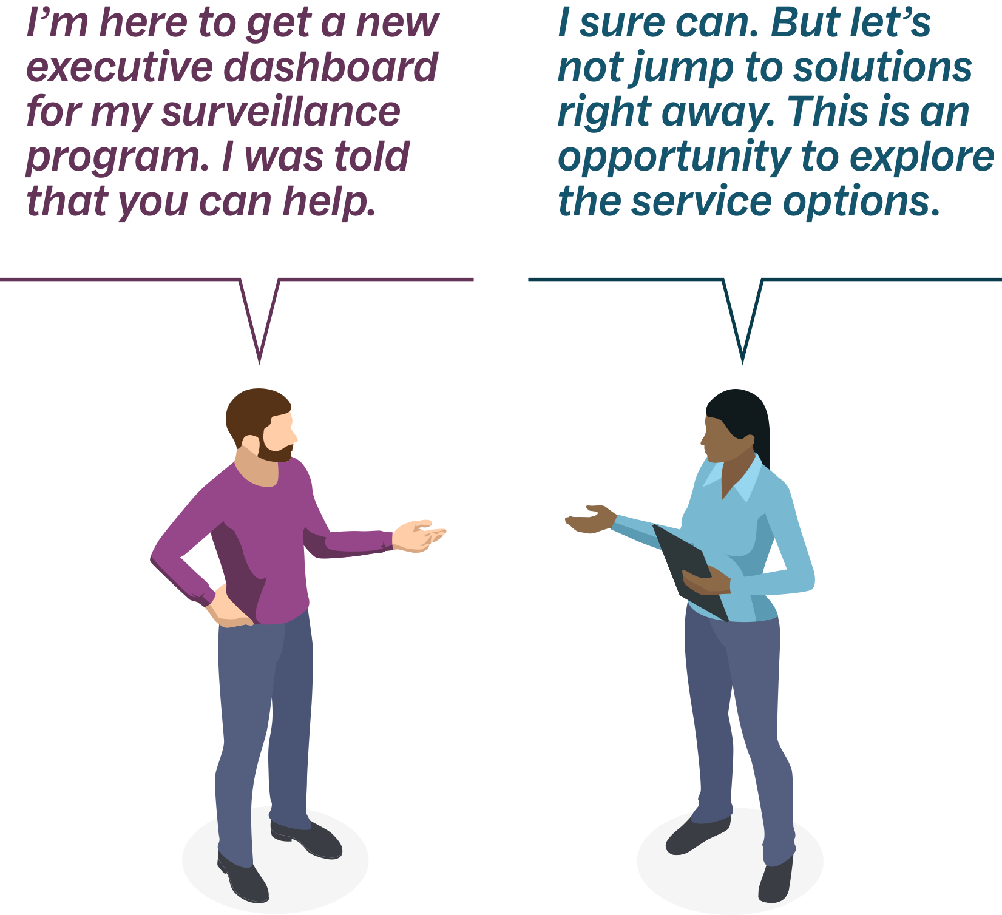

Slide 16
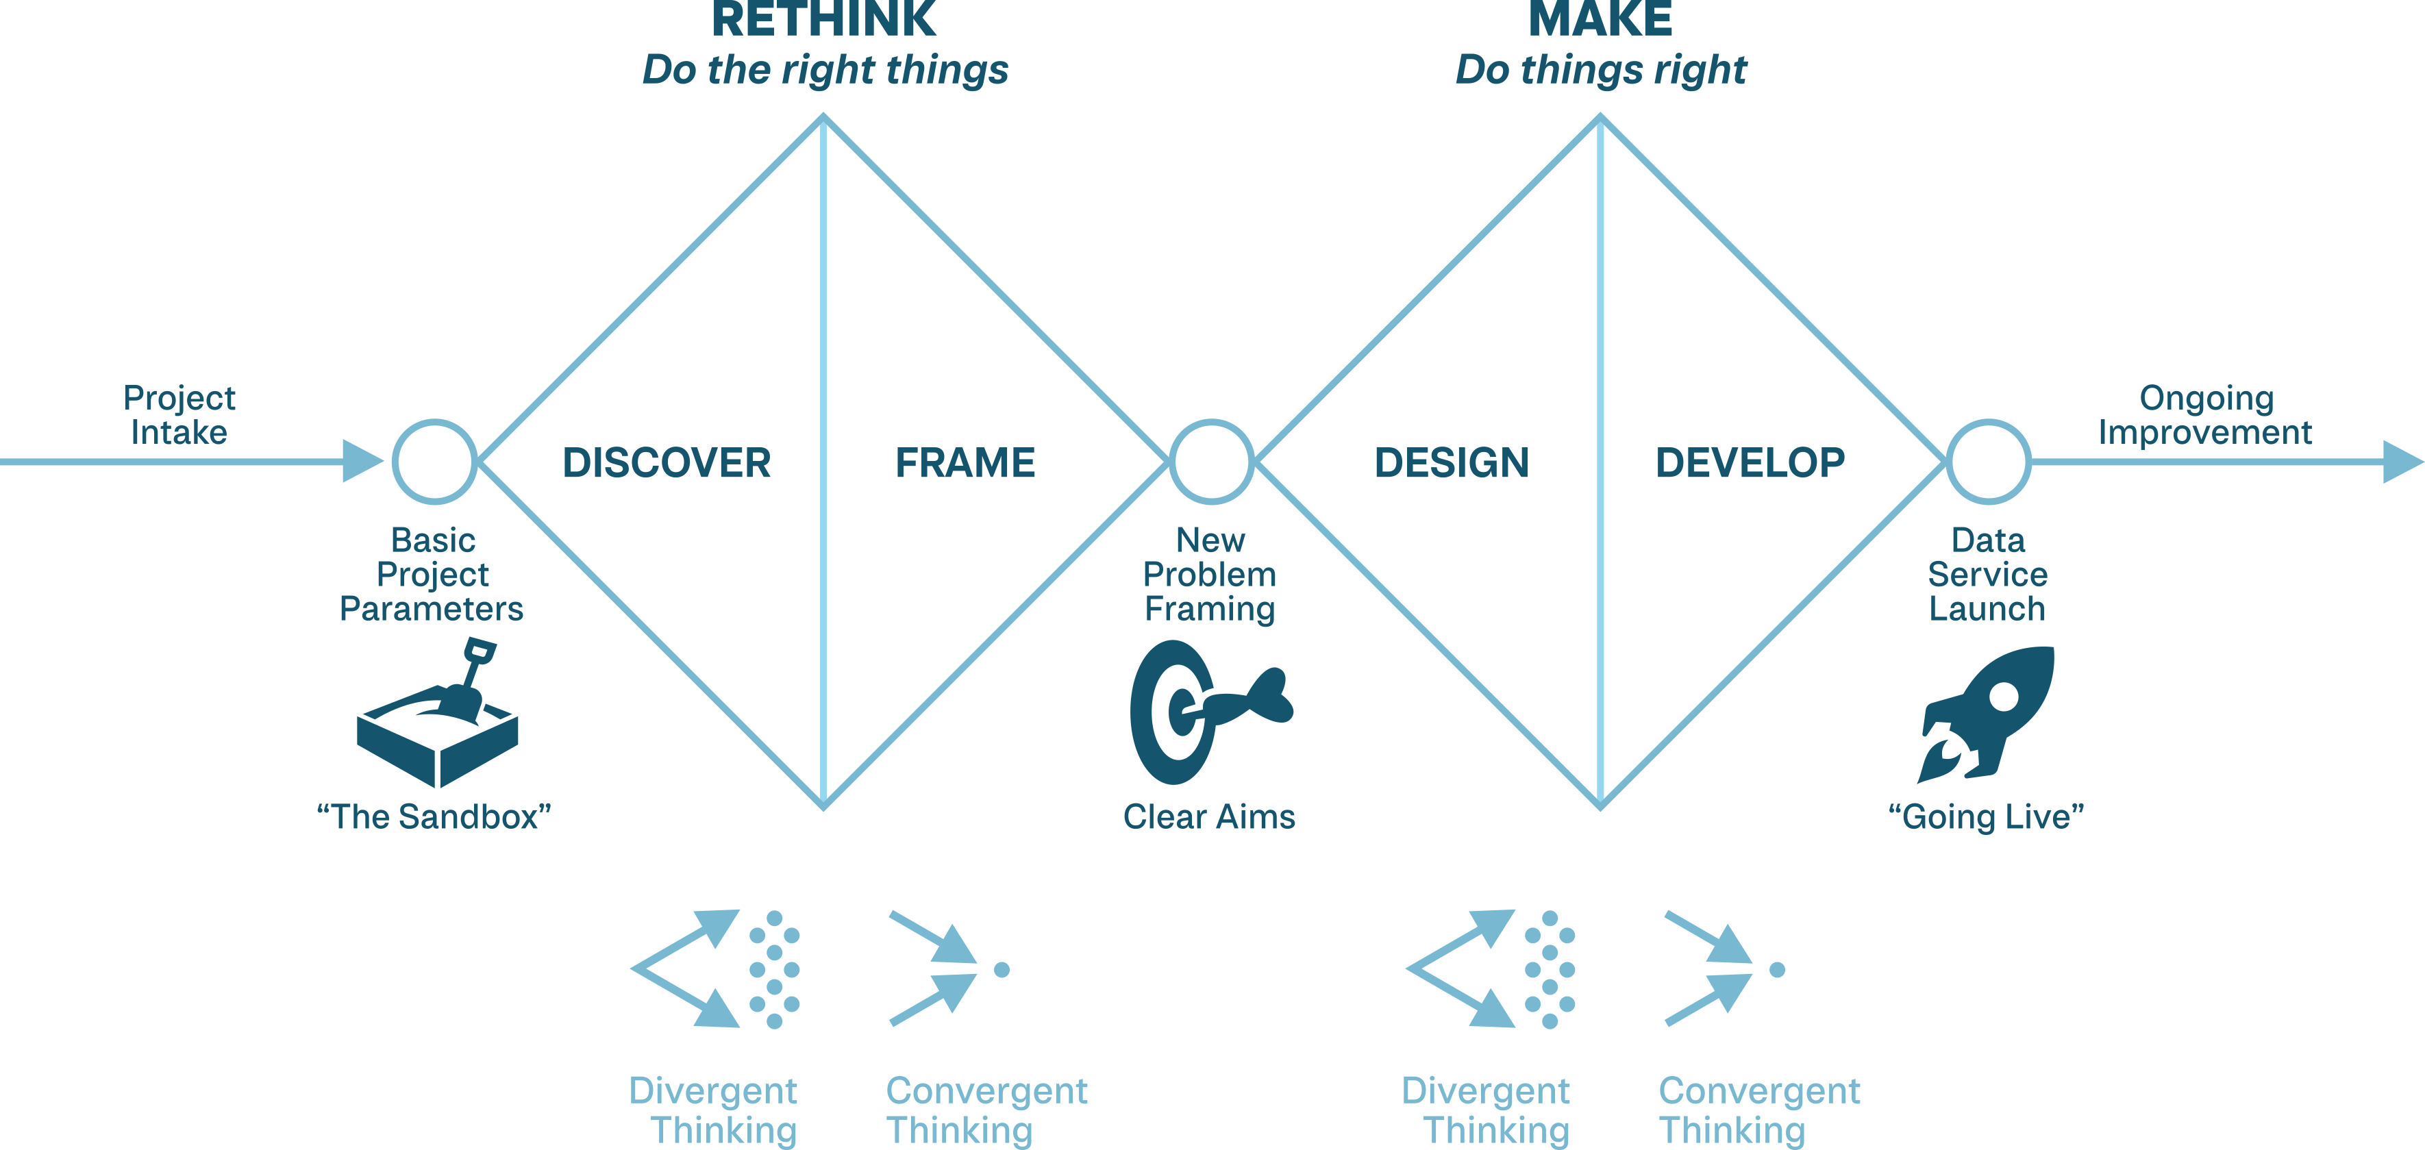

Slide 26
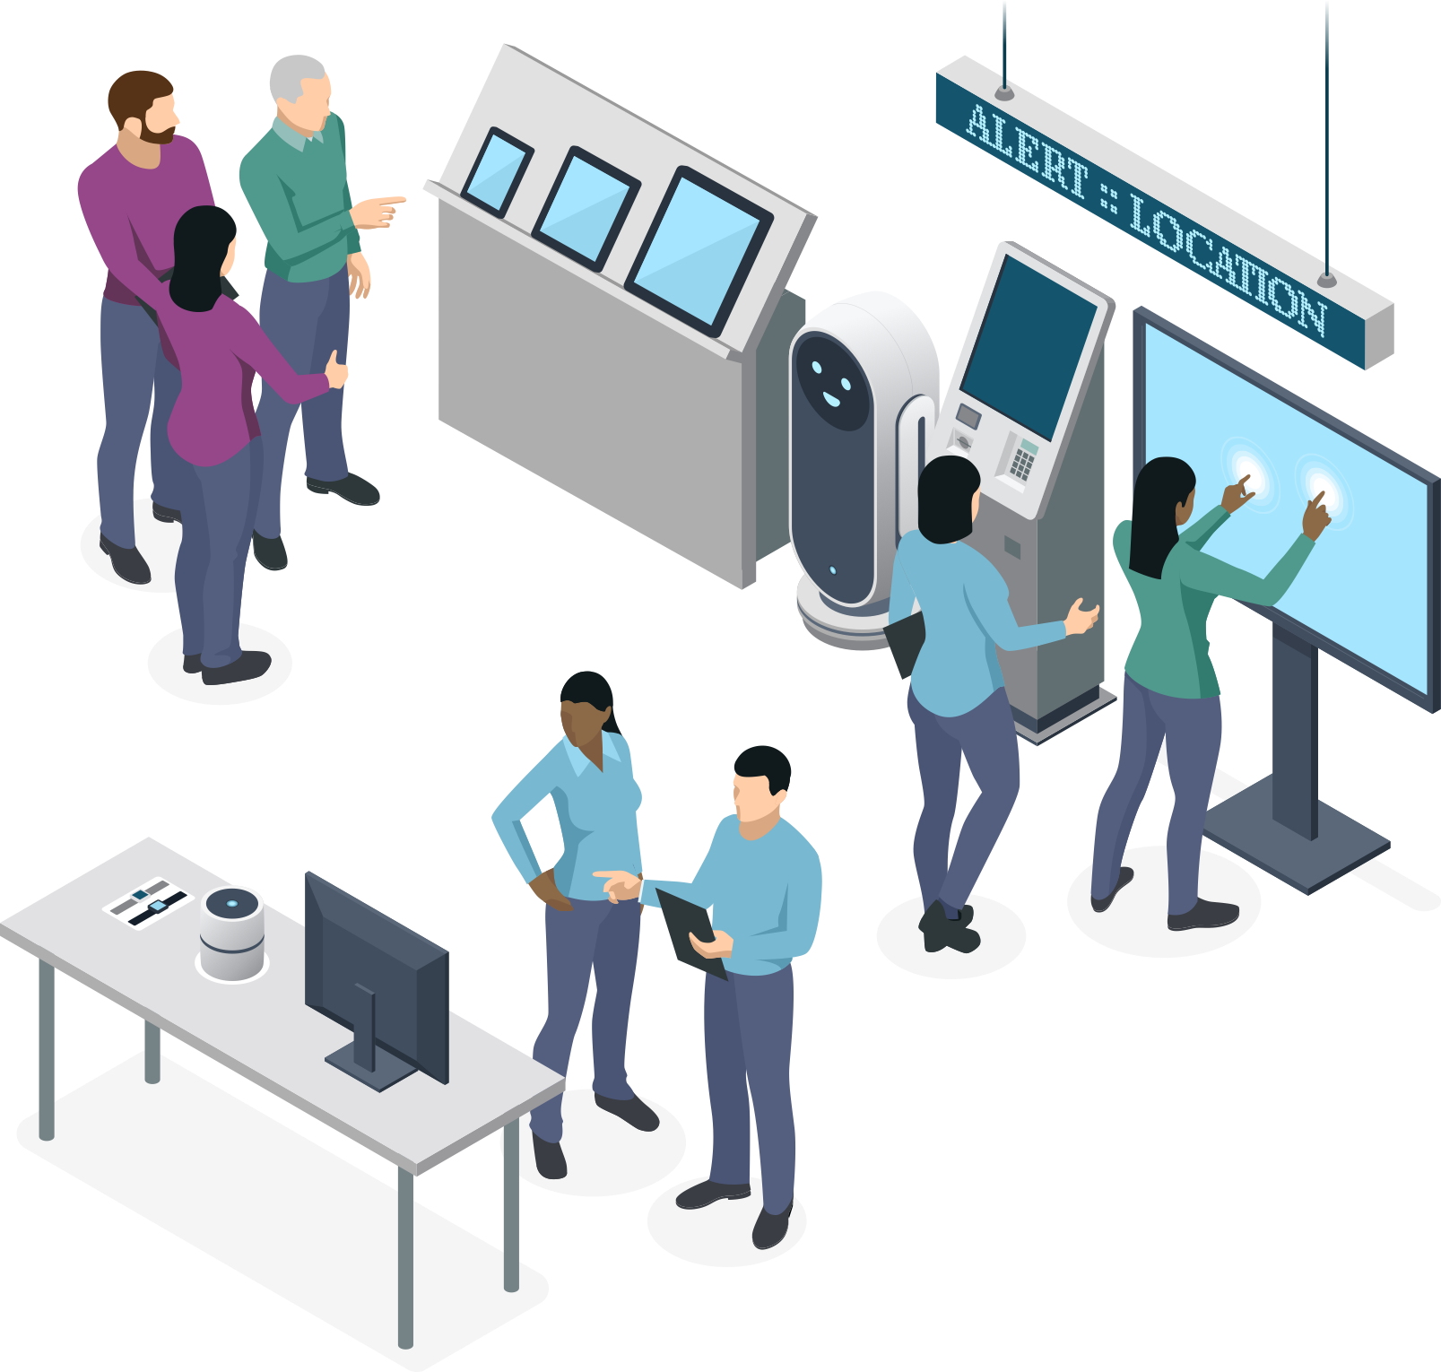
SERVICE CHANNELS

Slide 28
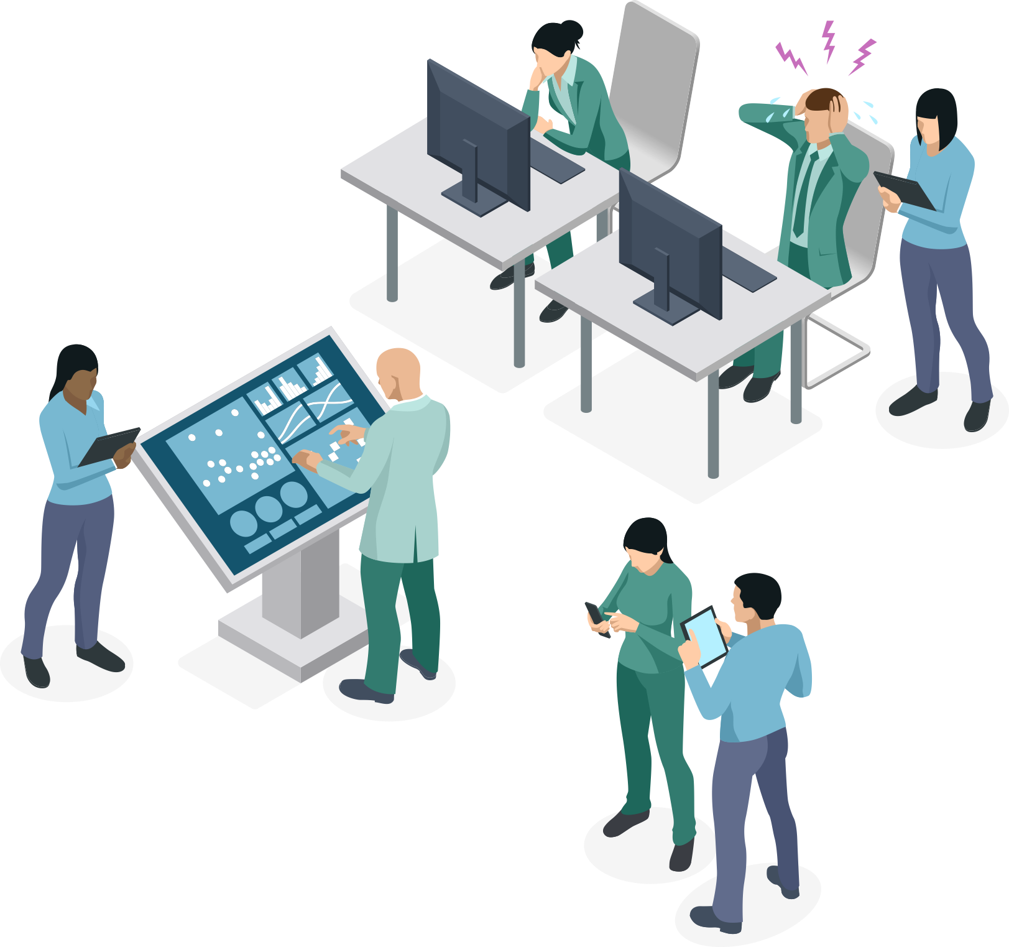

Slide 29
SHARING & REUSE

Slide 30
FIELD TESTING

Slide 32
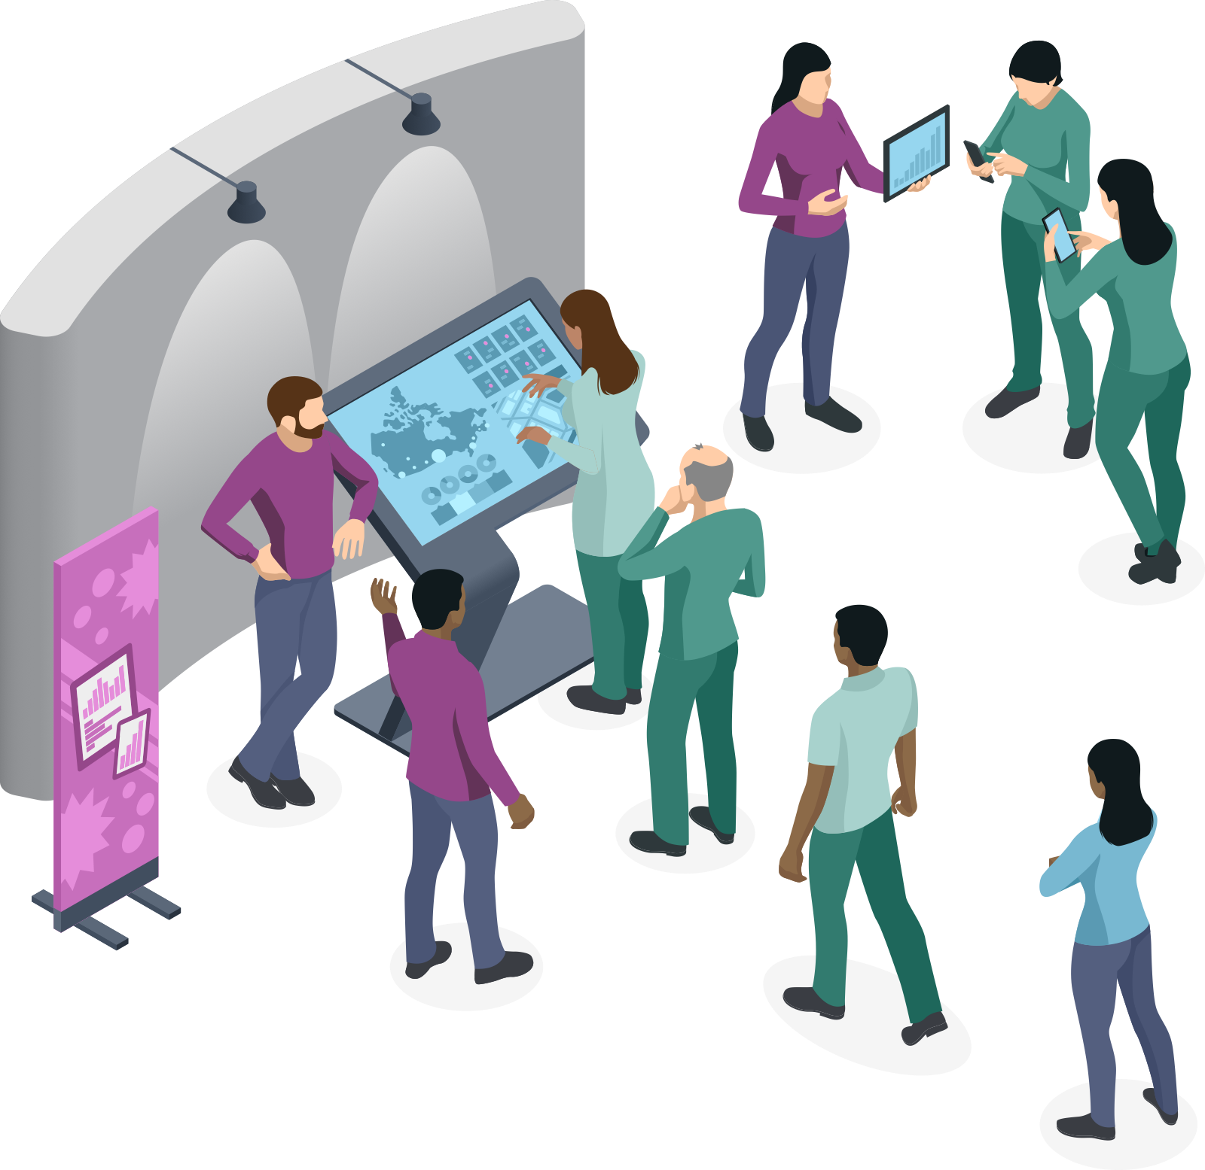

Slide 38
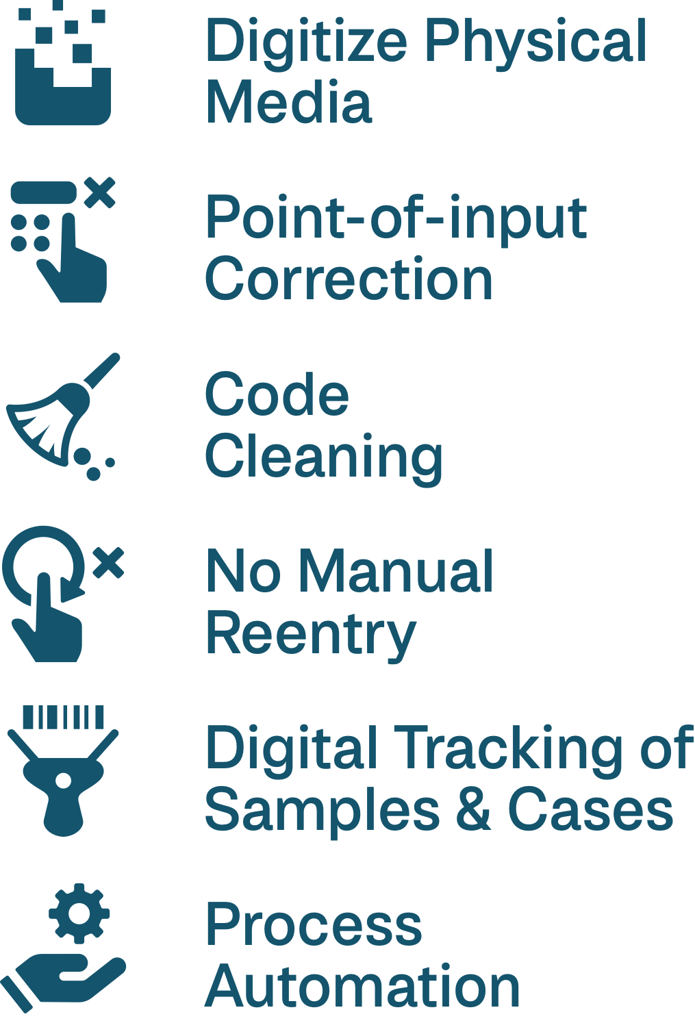
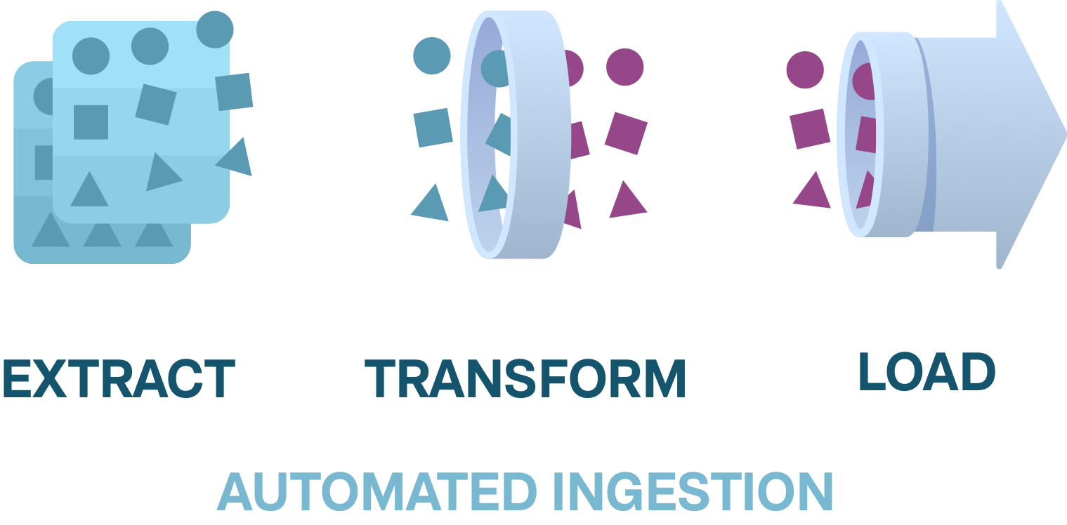

Slide 39
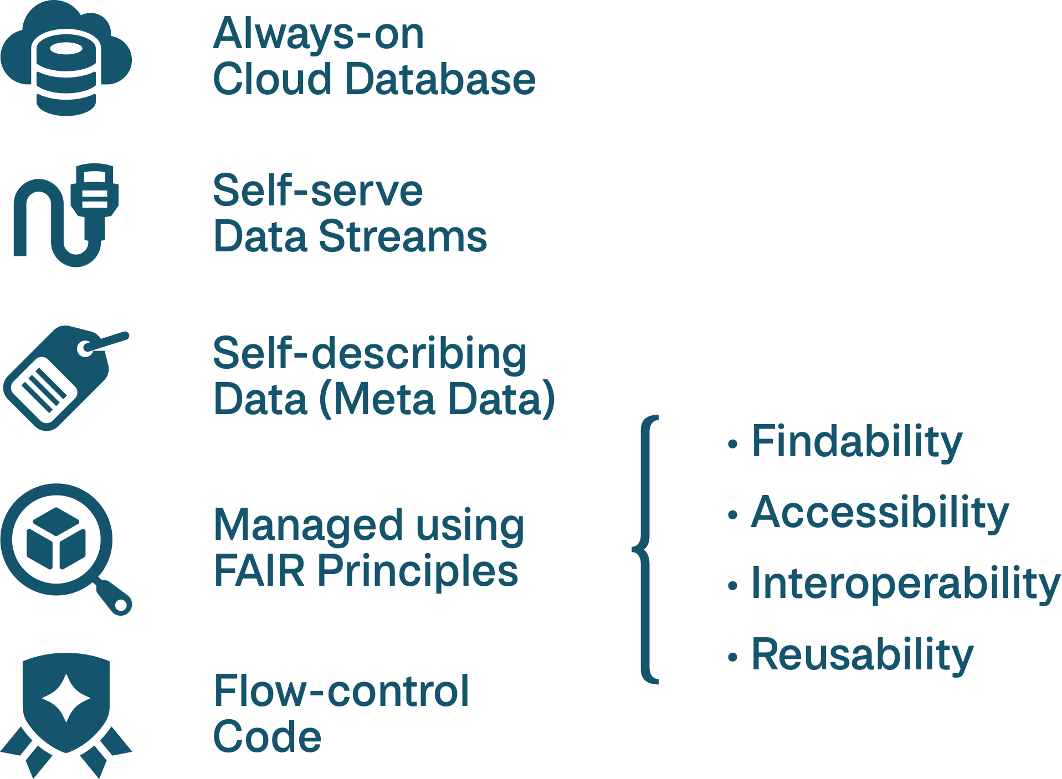

Slide 40
