Slide 1
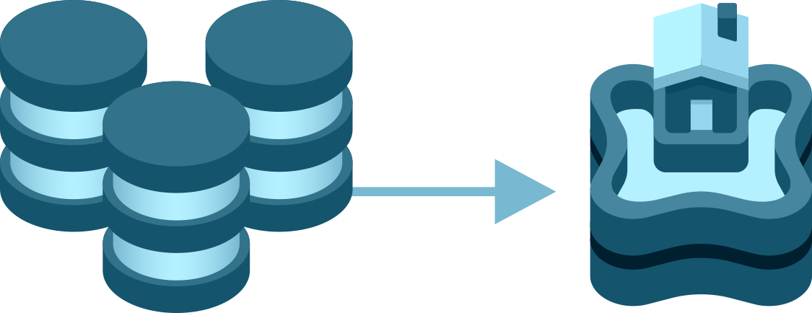
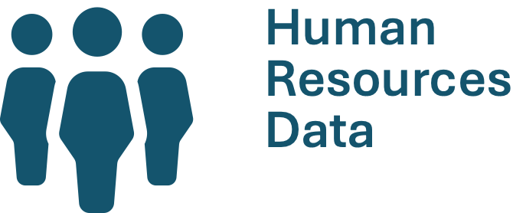
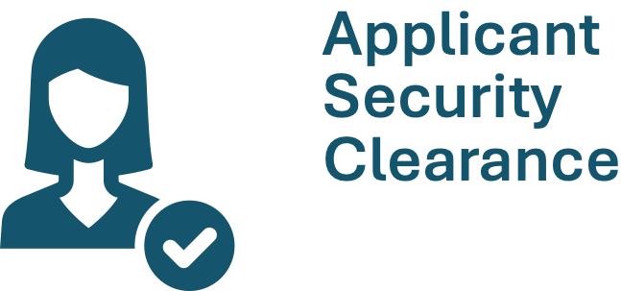



ORION: Enterprise Datasets Project
UNCLASSIFIED
WHAT
USE CASES
An integrated HR model will
answer the question: Who
does what, where, and for
what reason?
A project to speed up the adoption of
ORION by ingesting enterprise datasets
of high operational value across the
enterprise.
A new model automates an
existing manual process that
provides key metrics for the
security screening process,
which also alleviate stress on
the vendor’s API connection.
CURRENT STATUS
19 data
models
ingested
Cloud-to-ground
gateway connections
established to HR
and financial
sources.
A financial model will provide
a standardized, consolidated
view of financial information
across the enterprise.

