Slide 1
DIGITAL SERVICES GROUP
CDTO / DG DAIM / DDAE
UNCLASSIFIED
The ORION Unified Data Layer
Briefing
June 26, 2026

Slide 2



ORION: the data foundation of next-generation Defence capability
A sovereign, AI-enabled, mission-ready
Defence by 2030 that responds to threats
rapidly and effectively
Data flows to the right people at the right times
in the right forms to support integrated analysis
and decision advantage.
VISION
A unified data layer based on standards that
enables data to interoperate across domains and
allies at high speed in a trusted and secure way
Data integration supports Pan-Domain
Command & Control (PDC2) platforms and
the warfighter operating in challenging
mission environments
OBJECTIVE
UNCLASSIFIED

Slide 3
And the culmination of several defence policies and strategies
2017
2024
2025
2026
2026
2026
Defence Policy
Defence Vision
AI Strategy
Industrial Strategy
Digital Strategy
National AI Strategy
UNCLASSIFIED

Slide 4

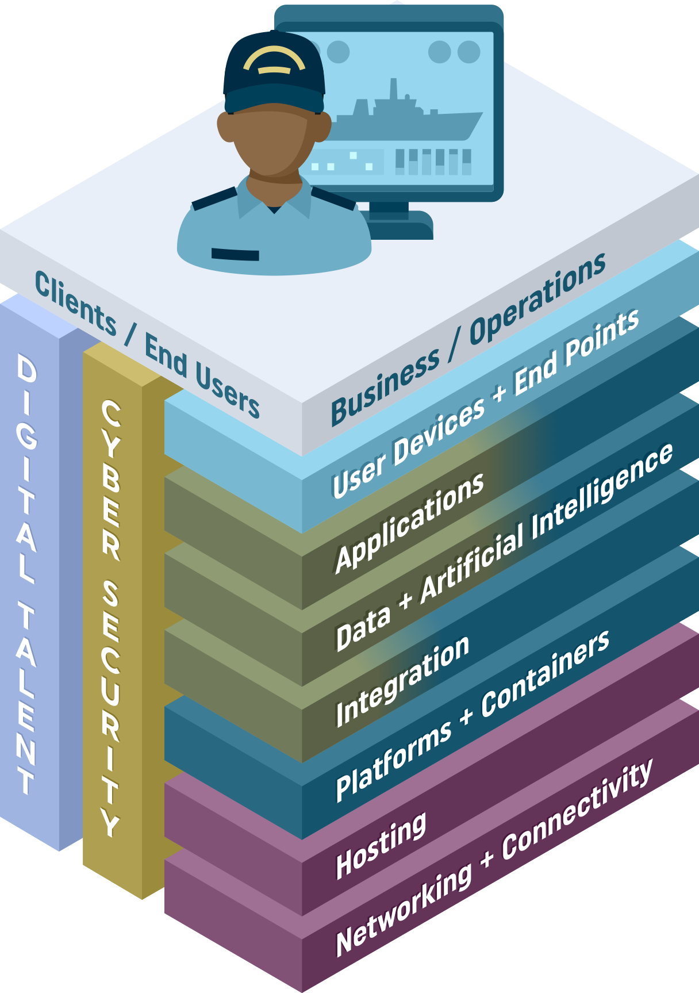


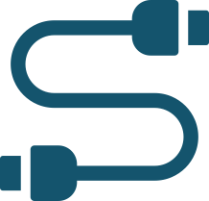
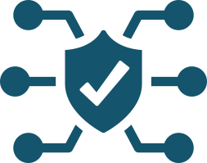



The demands of enterprise operations and AI
Defence requires integrative data systems, mature DevOps,
and super-computing capabilities across cloud levels.
High quality data flowing at volume and speed are necessary to get ahead of threats
Sovereignty is preserved by reducing dependencies on proprietary foreign technologies
Interoperability
across systems
enables data reuse
Governance involves maintaining standards while letting domains steward data to suit their needs
Standards ensure
data does not get
stuck in siloes.
Defence Use of AI
requires safeguards
and transparency
Data systems have
to work reliably under
harsh Edge/DDIL
Conditions.*
* Denied, Degraded, Intermittent,
and Low-bandwidth
UNCLASSIFIED

Slide 5
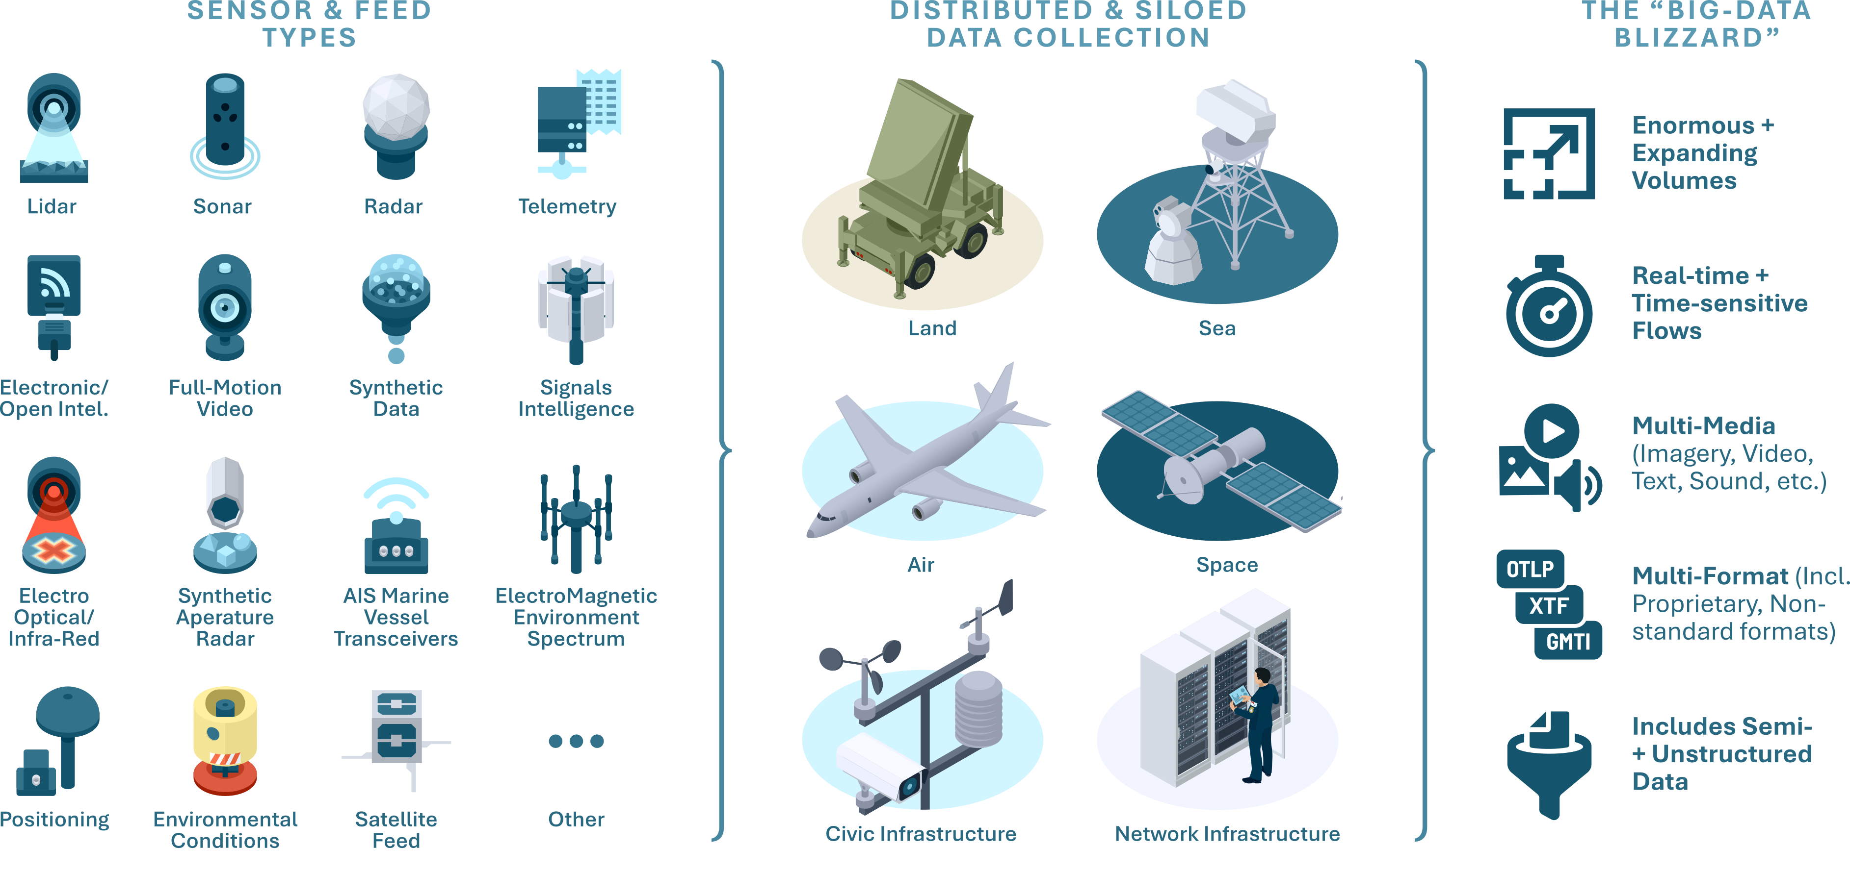
The deluge of sensor data can overwhelm integration efforts
UNCLASSIFIED
UNCLASSIFIED

Slide 6
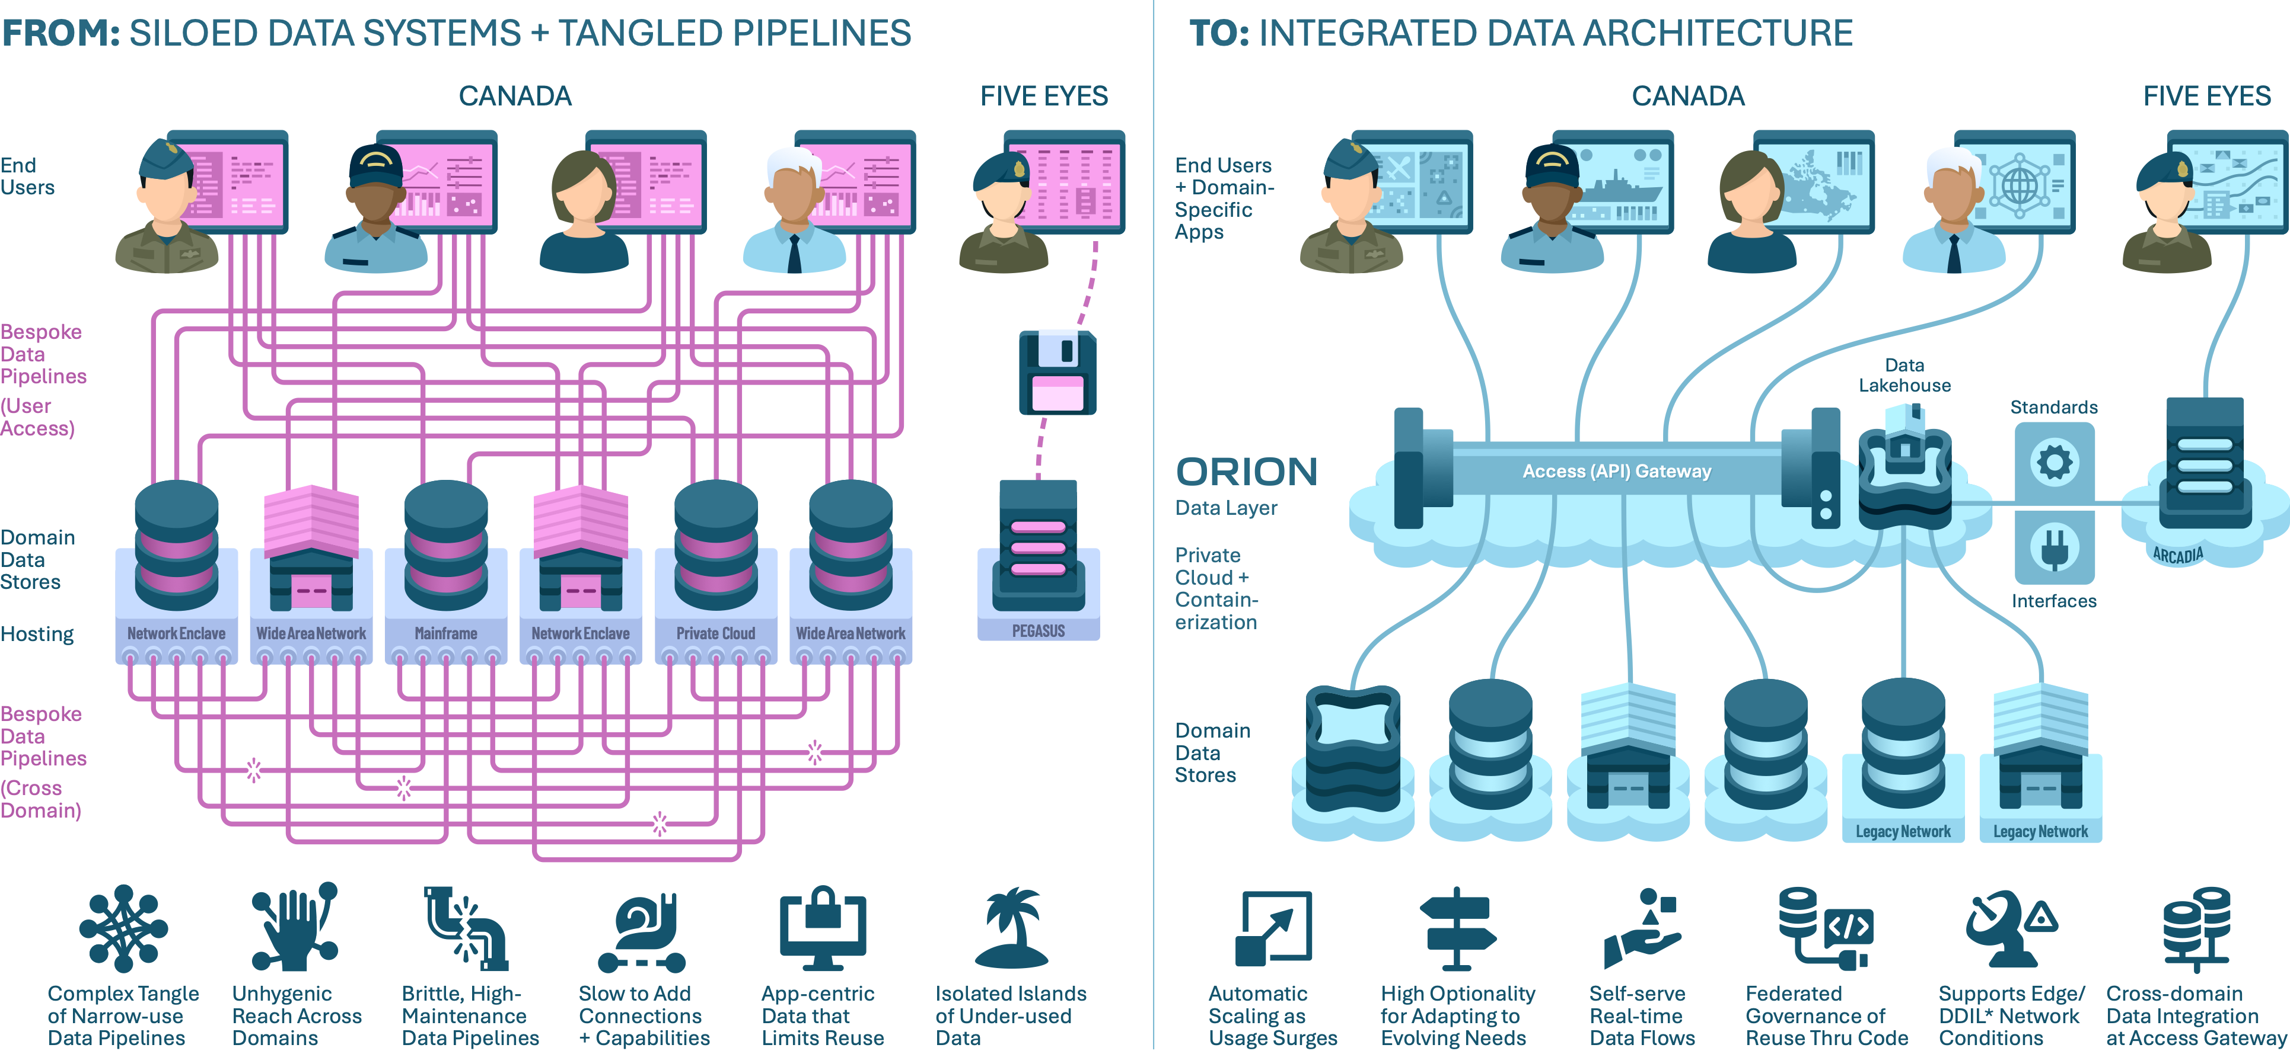
From Silos to Integration
UNCLASSIFIED
UNCLASSIFIED

Slide 7
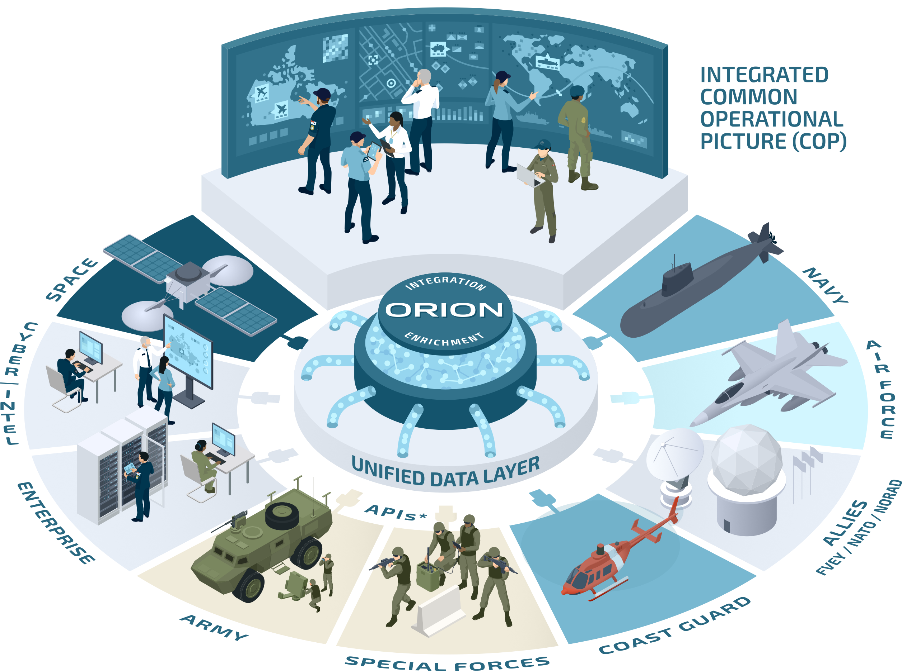



What is ORION?
ORION is the unified data layer of the
Department of Defence and Canadian
Armed Forces.
Hybrid Cloud/On-Premise
Platform integrates data
from across domains
Fast Big-Data Flows (peta-
bytes) accessible from a
convenient access point
Services, Standards, and
Interfaces add value as
data is aggregated or flows
through the layer
Common Operational
Picture supports decision-
making and situational
awareness on the battlefield
UNCLASSIFIED

Slide 8
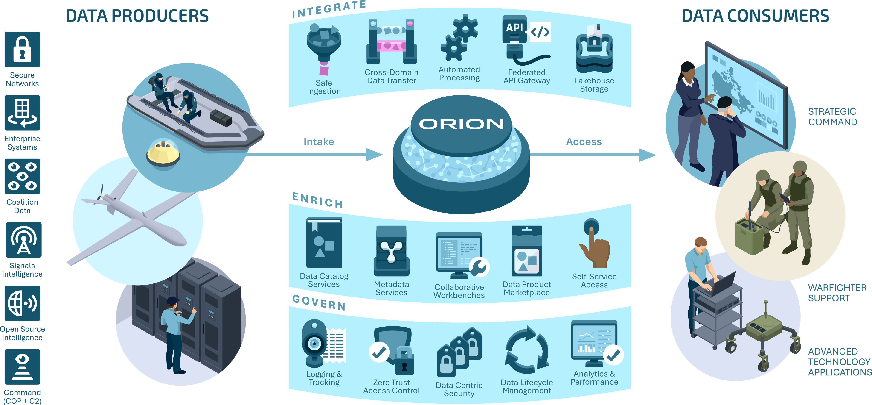
ORION Value Proposition
UNCLASSIFIED
UNCLASSIFIED

Slide 9
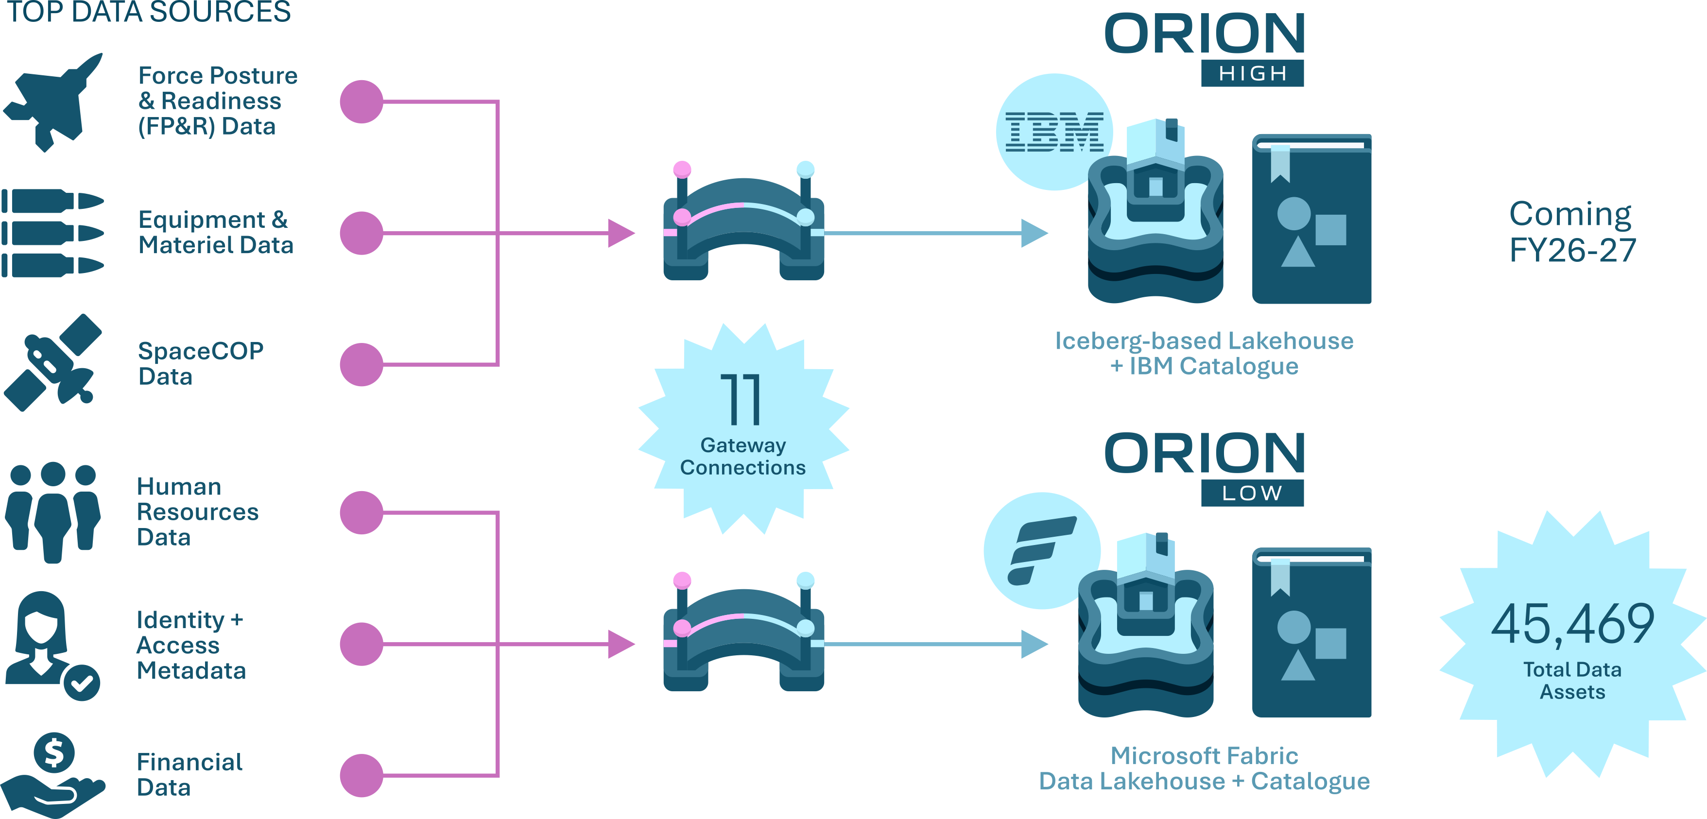
Supply: early shifting of data has already created a critical mass
UNCLASSIFIED

Slide 10
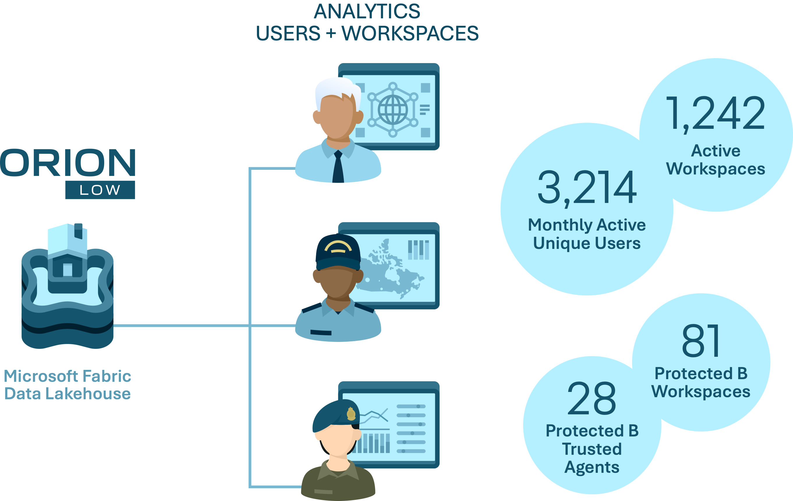
Demand: a growing user base is already consuming ORION data
UNCLASSIFIED

Slide 11
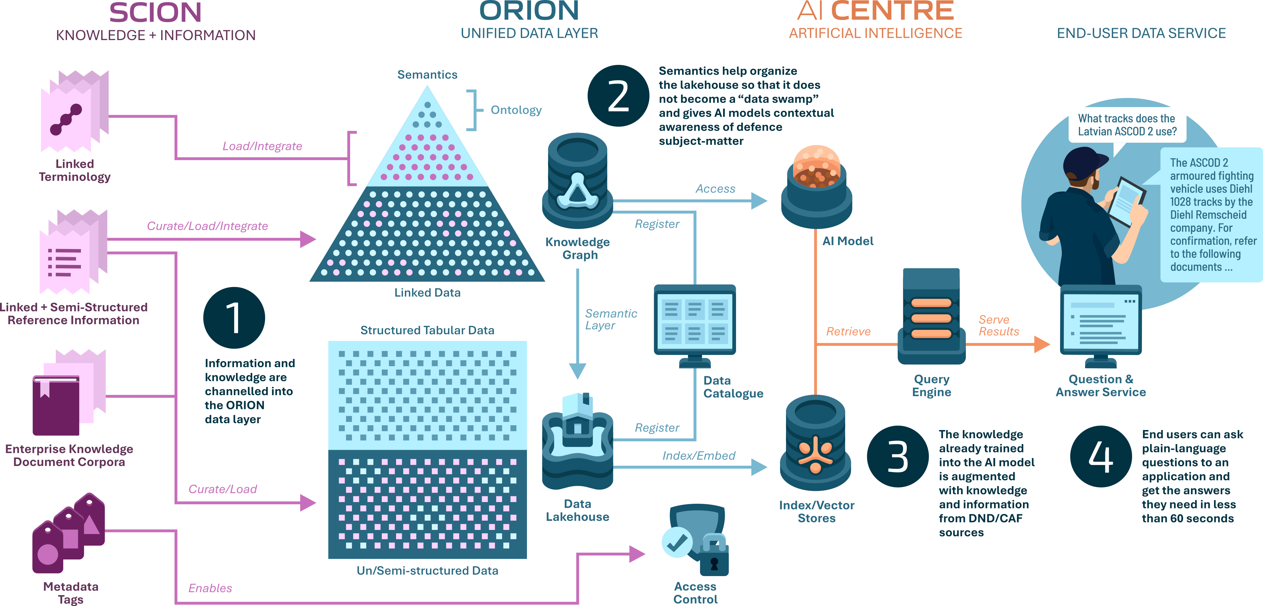
ORION infrastructure supports information management and AI
UNCLASSIFIED

Slide 12
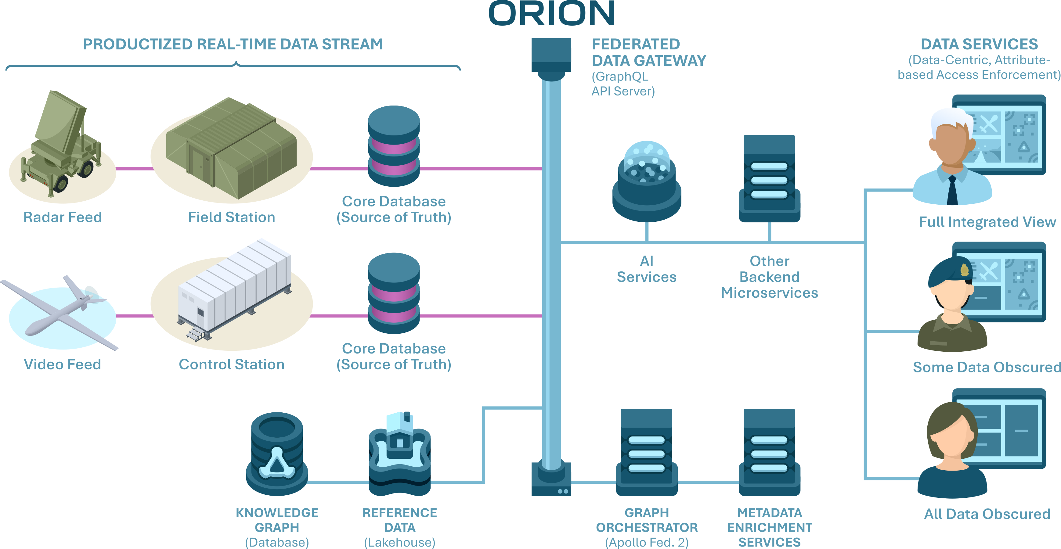
Data mesh: enriched real-time streams + fine-grained access control
UNCLASSIFIED

Slide 13

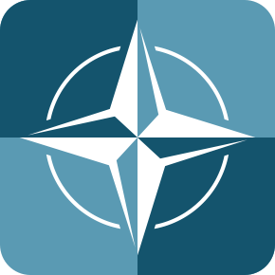




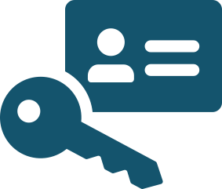

ORION is being built with the highest security standards
Network-Centric Security uses defence perimeters around the edges of network zones and comms
channels to keep hostile intruders out.
NATO DCS
MATURITY LEVELS
Data-Centric Security focuses protection on the
data, during its entire lifecycle, regardless of where it
is located. To accomplish that, data becomes:
Majority of new data labelled
Basic set of metadata labels
Document-centric protection
User-initiated, human-paced
self-contained (end-to-end encryption);
self-describing (labelled with trusted metadata);
self-enforcing (bound to governance policies).
Majority of all data labelled
Full set of metadata labels
Data-centric protection
Pre-defined policy model
Attribute-based Access Control
Machine-to-machine, real-time
Zero Trust Architecture
secures every application
and data store separately
to prevent cascading
security breeches.
Attribute-Based Access
Control (ABAC) ensures
data access is governed
according to fine-grained
usage policies.
Federation enables
distributed data and
decentralized identity,
credentials, and access
management (ICAM)
Full cryptographic protection
Full lifecycle coverage
Control anywhere data resides
UNCLASSIFIED

Slide 14
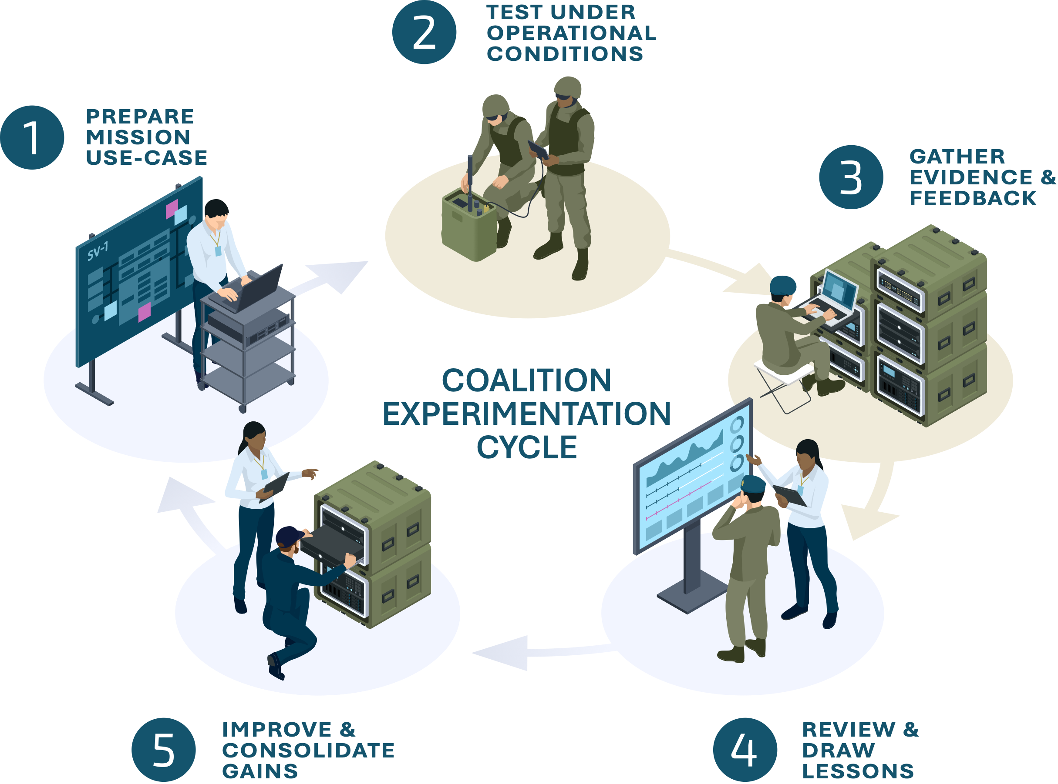





Development through cycles of continuous learning in the field
Realistic Coalition
Environments for
Testing
Measure what
Matters, Not Just
Compliance
Effectiveness,
Performance, and
Contextual Indicators
Telemetry Data
for End-to-End
Systems View
Durable Capability
Gains from Cycle
to Cycle
UNCLASSIFIED

Slide 15
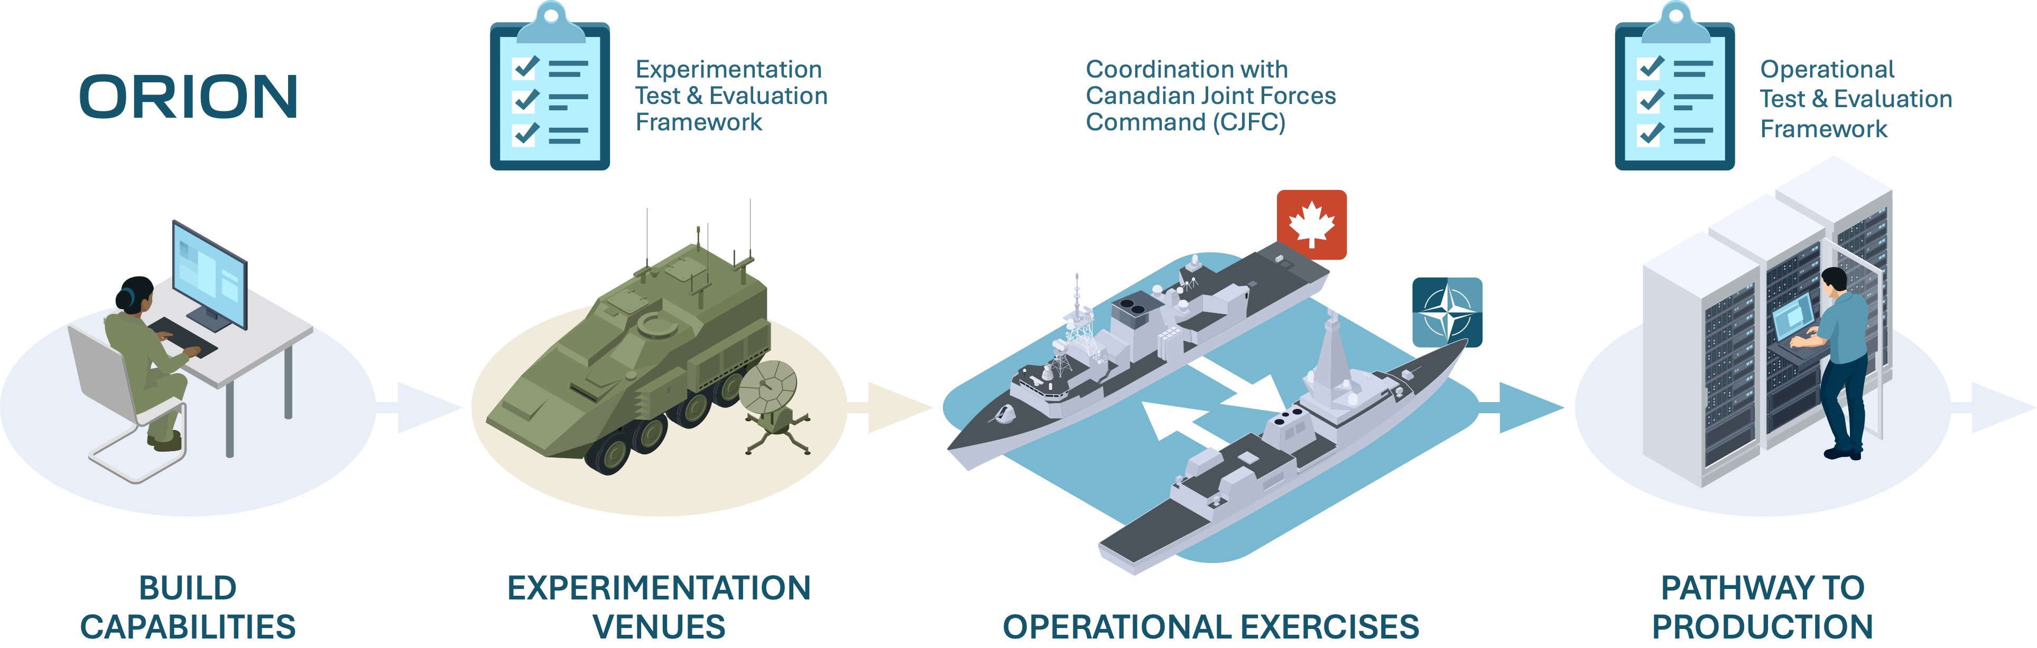


Test and Evaluation Framework
Partnerships with Canadian Joint Forces Command (CJFC)
and other Canadian Armed
Forces stakeholders
Demonstrate and field test in US-led
experimental events (such as BoldQuest)
and major operational exercises (such as
HighMast)
UNCLASSIFIED

Slide 16
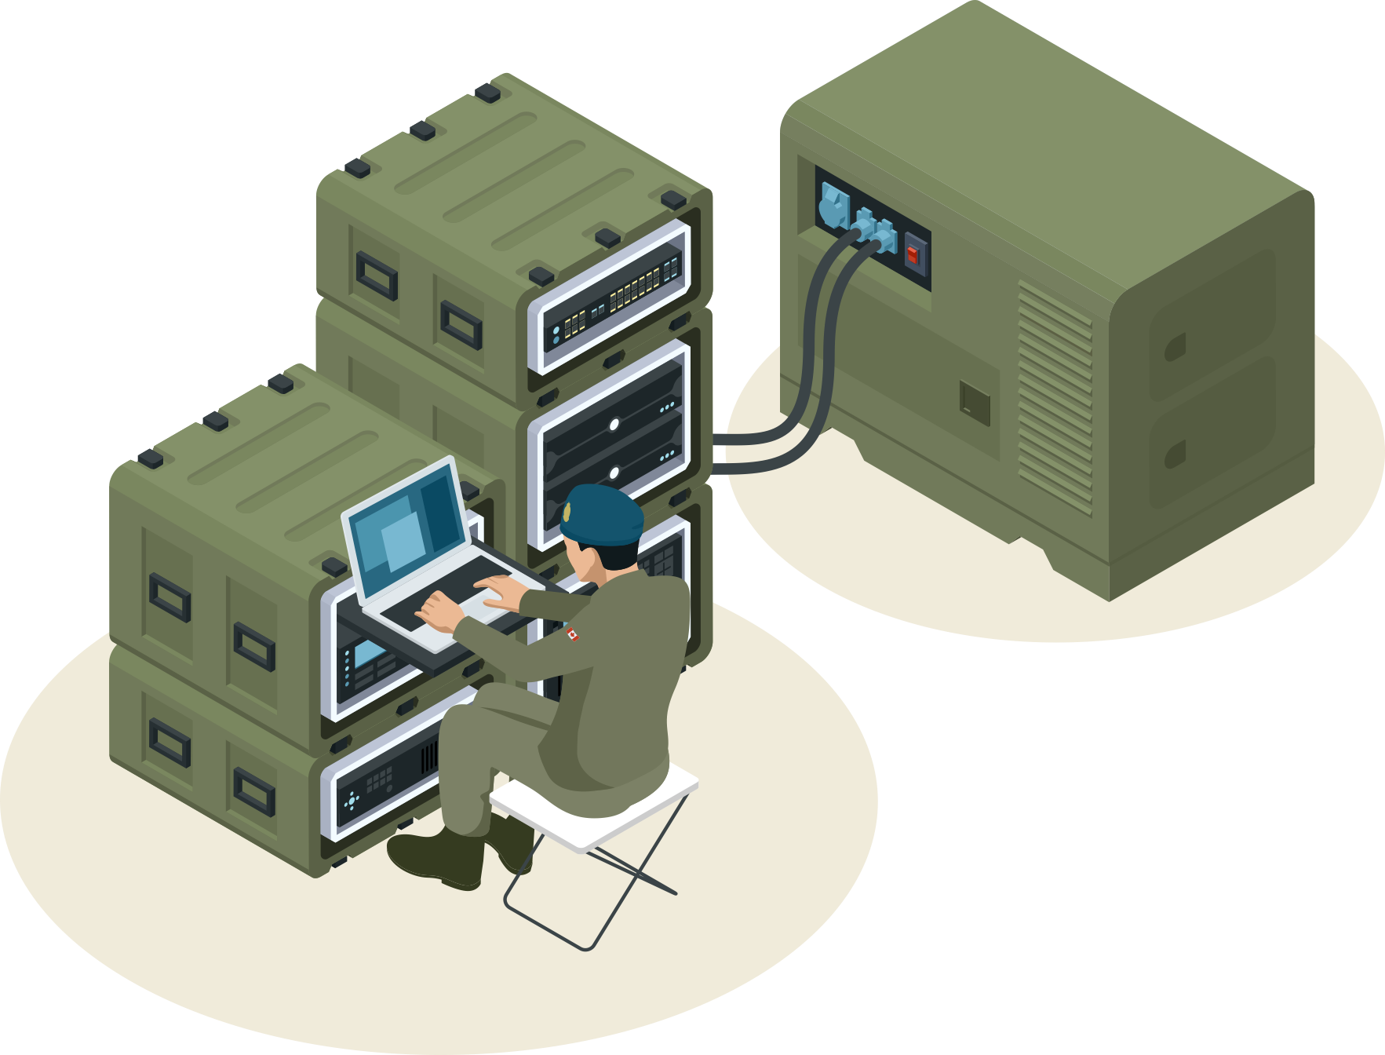
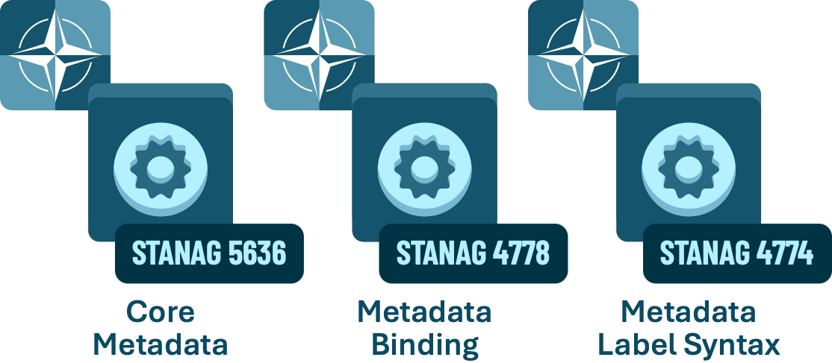
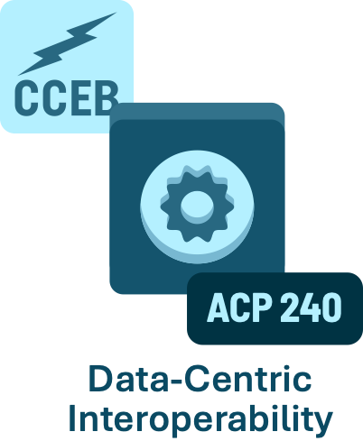
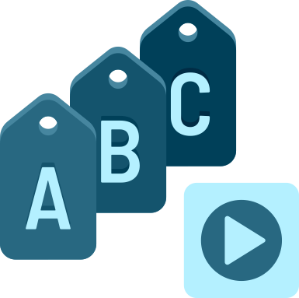


Current allied interoperability cycle (Bold Quest 2026)
STANDARDS IMPLEMENTATION
Target alignment to these NATO standards at
DCS Level 2
Packaging and ICAM
enforcement via Keycloak
SCOPE
Full-motion video,
data catalogue, and
catalogue federation
Metadata tagging
and enrichment
for full-motion video
IBM-based stack (on-
premises + air-gapped)
in development
If the cycle is successful, further progress
will be made for Operation Olympus Fires.
ICAM: Identity, Credentials, and Access Management

Slide 17
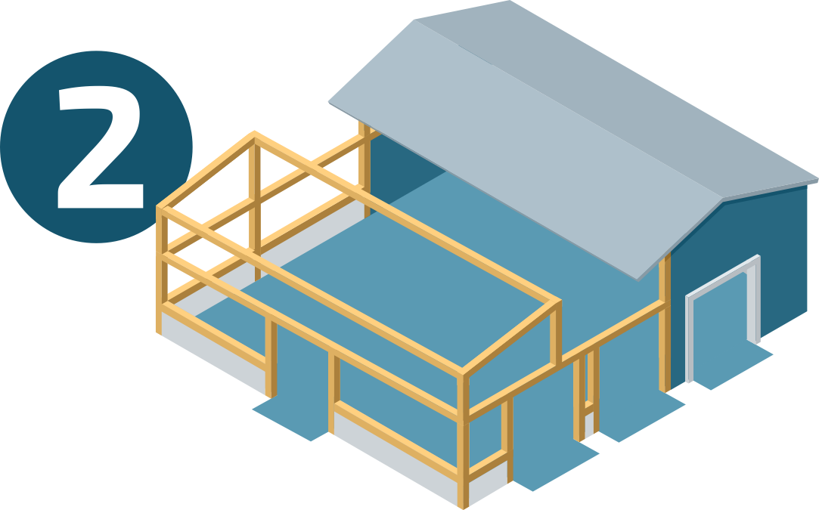
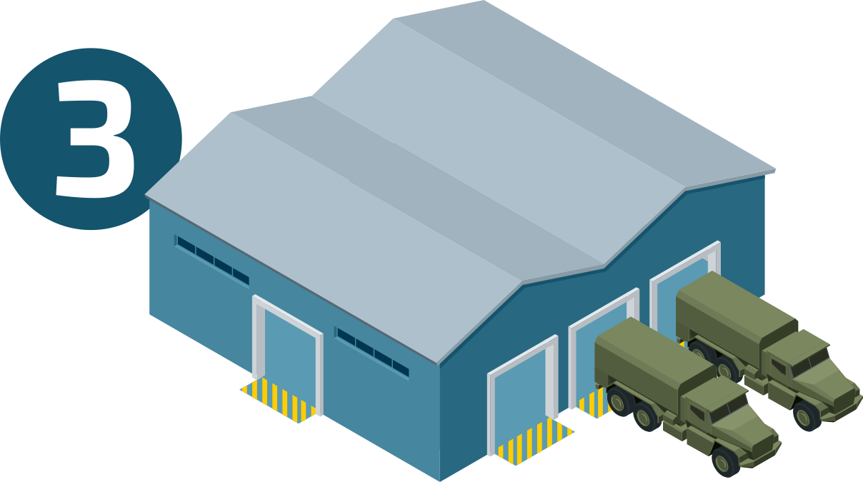
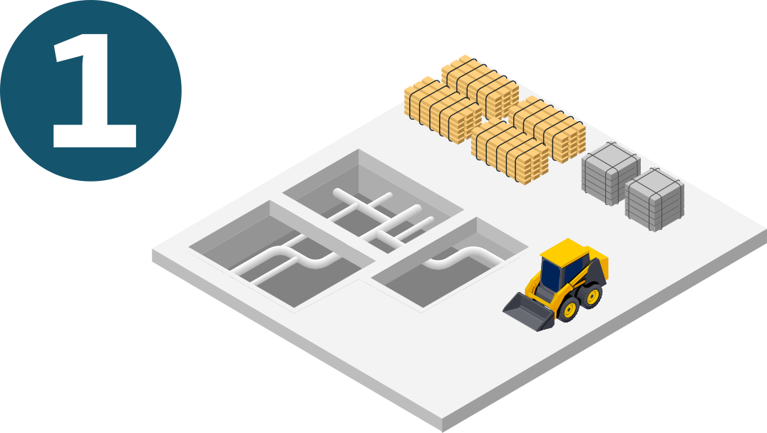
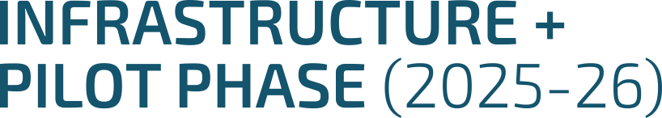
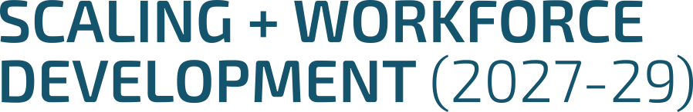

High-level build-out
UNCLASSIFIED
Think of capacity building as the construction of a warehouse
handling high volumes of urgent packages
Establish foundational data
analytics and Artificial
Intelligence (AI) capabilities
Expand adoption of data
platforms, cloud services,
and AI capabilities, while
enhancing workforce skills
Achieve advanced capabilities
and global interoperability of
mission-critical data

Slide 18
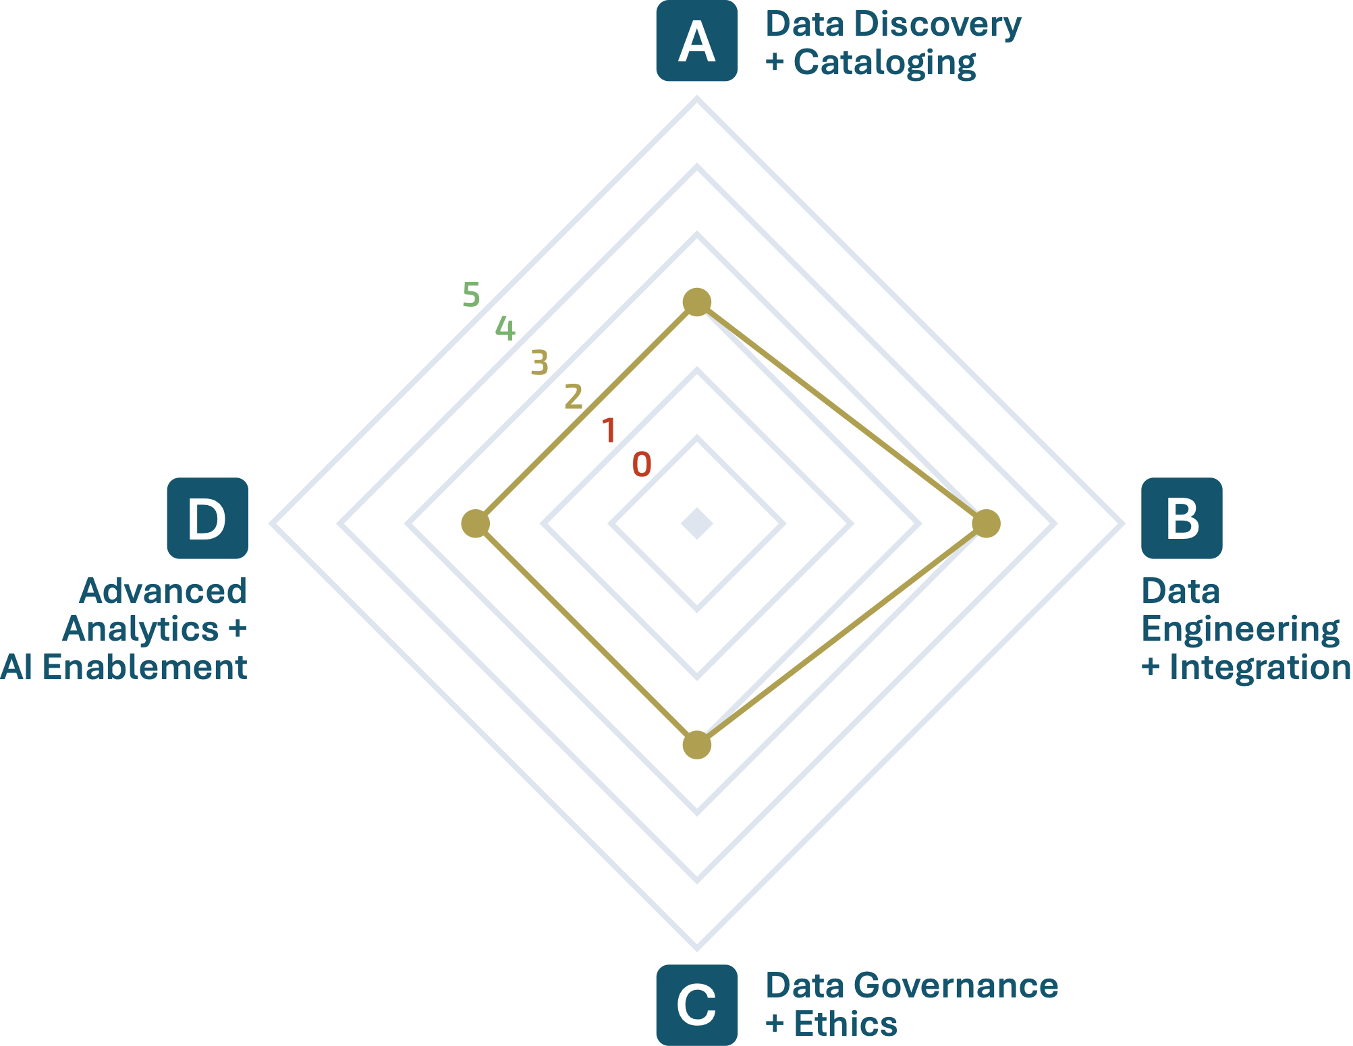






Digital Foundations Architecture Scorecard: Lots of Work To Do
UNCLASSIFIED
Data Discovery
+ Cataloging
Data Engineering
+ Integration
Baseline metadata directive and tagging
Low-to-high security data pipeline pilot
Data catalogue pilots for
protected + secure clouds
Some enterprise datasets
identified and profiled
Enterprise-wide metadata
management practices
Manual data ingestion dominates across systems
Incentives for tagging
and registering data
Semantic layer
Security over-classification
+ discoverability issues
Siloed pipelines and models
Data product stewardship
Data Governance
+ Ethics
Advanced Analytics
+ AI Enablement
Data Access Directive
DataMart-like workspaces
for business intelligence
Governance bodies, frame-
works, strategies + toolkit
Pilots for AI intake, adoption
and access
AI governance board and prioritization framework
AI talent management
and development
Unified data layer operating model
Change management
Formalization of stewardship responsibilities
Data integration into
AI workflows

Slide 19
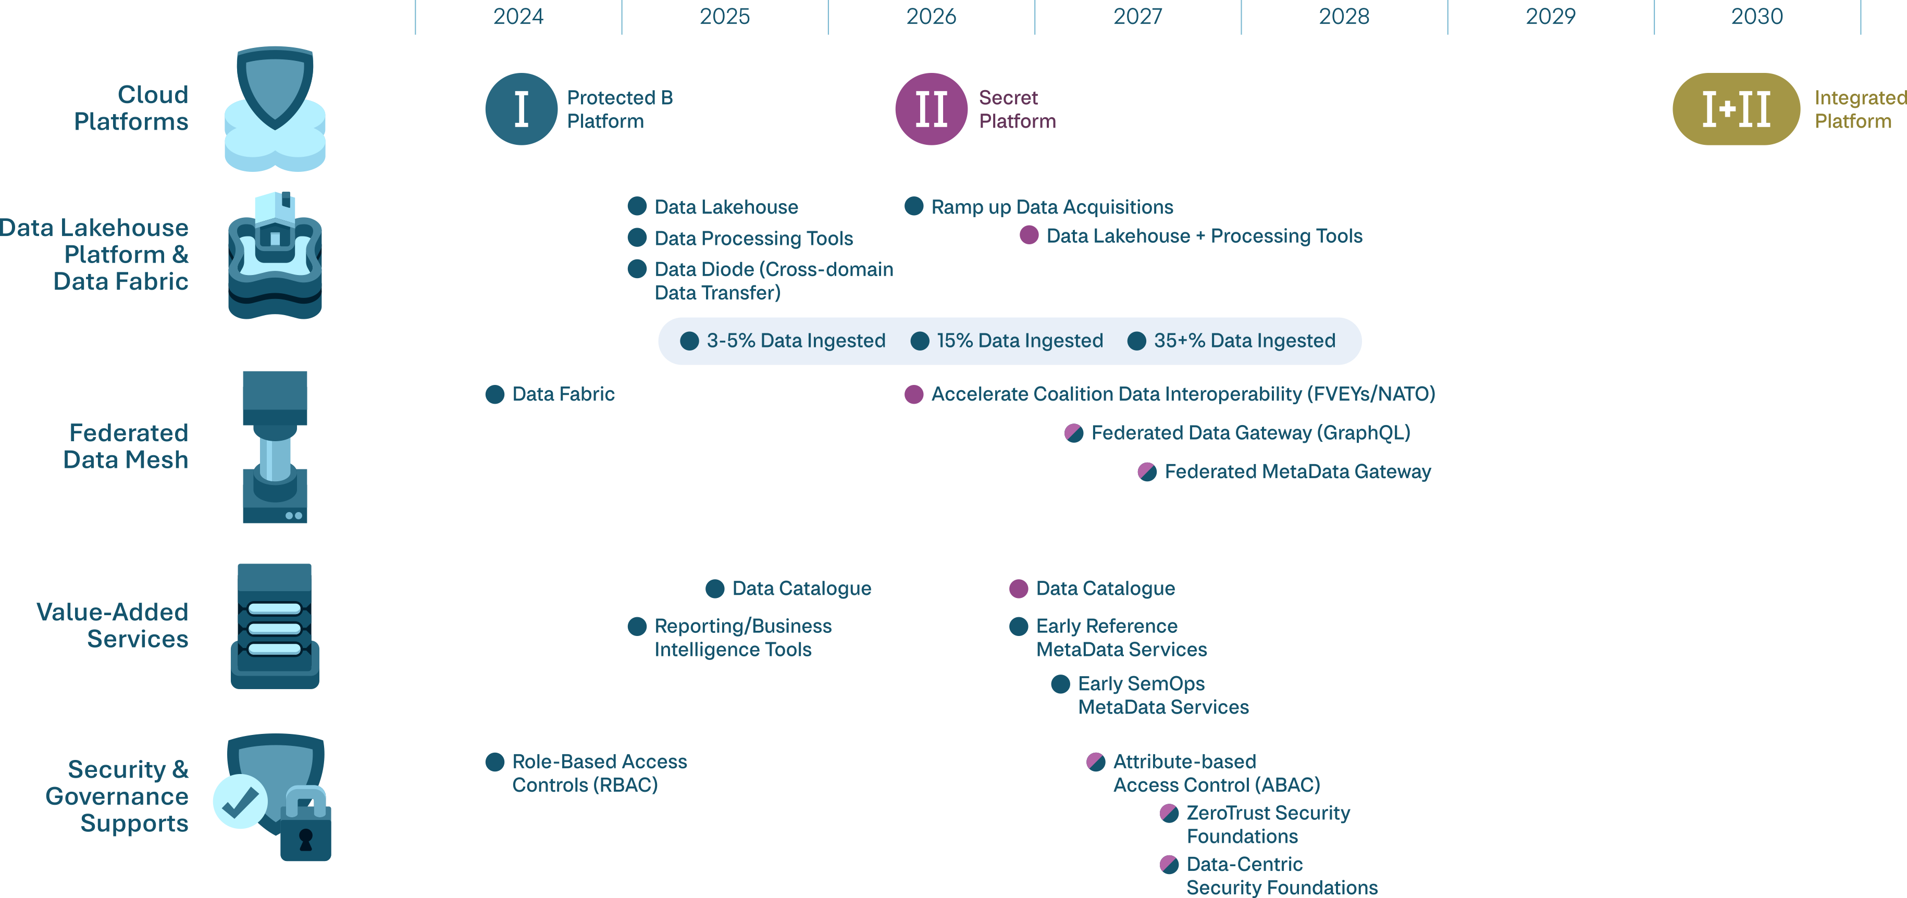
ORION Timeline
UNCLASSIFIED

Slide 20
Thank you
Seifallah Ayachi, Director
Data & Analytics Enablement
Seifallah.Ayachi@forces.gc.ca

